Slide 1
Restful API Development using Spring Rest & Spring Data JPA & H2 with Spring Boot
Demo of Spring Rest, Spring Data JPA and H2 to create restful services endpoints with Spring Boot

Slide 2

Create Rest endpoints to:
– Create an Employee resource
– Retrieve List of Employees
– Retrieve Employee
– Update Employee resource
– Delete Employee resource
Agenda

Slide 3
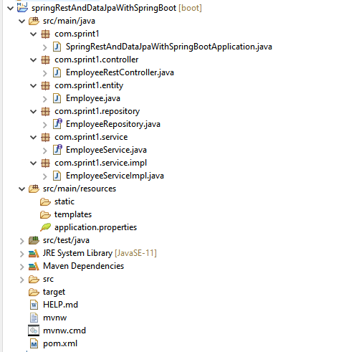
Project Structure

Slide 4
Step 1
– Create project springRestAndDataJpaWithSpringBoot
(via Spring Initializer)
Step 2
– add dependencies to enable Swagger
Step 3
- @EnableSwagger2 annotation
Step 4
- Create Employee entity
Step 5
- Create Rest Controller with all operations.
Process Flow

Slide 5
Step 6
Create Service interface with methods required to
- retrieve the list of employees
- retrieve one employee
- save employee in the database
- delete an employee
- update and employee.
Step 7
Create Implementation class for the interface created in Step 6
Step 8
Create a repository class, which will extend Spring data JPA JpaRepository and hence will provide the methods to perform CRUD operations out of the box.
Process Flow (contd.)

Slide 6
Step 9
Enable the H2 database web console by updating the application.properties file.
Also add in the following:
spring.mvc.pathmatch.matching-strategy = ANT_PATH_MATCHER
Step 10
Run your main application class and it will make sure that it will build your code, package your code in the jar and deploy it onto the embedded tomcat server.
Step 11
Open H2 database console by hitting following URL:
http://localhost:8080/h2/
Process Flow (contd.)

